Slide 1

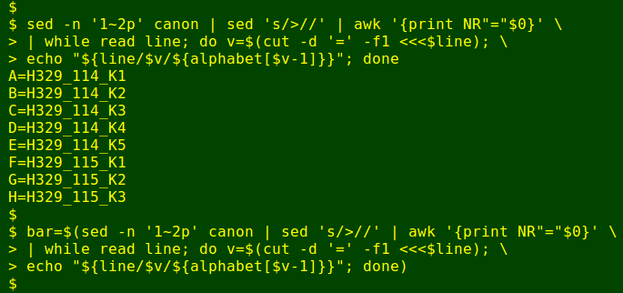
Linux Basics
Victor & Dean

Slide 2







So many kindz!!

Slide 3
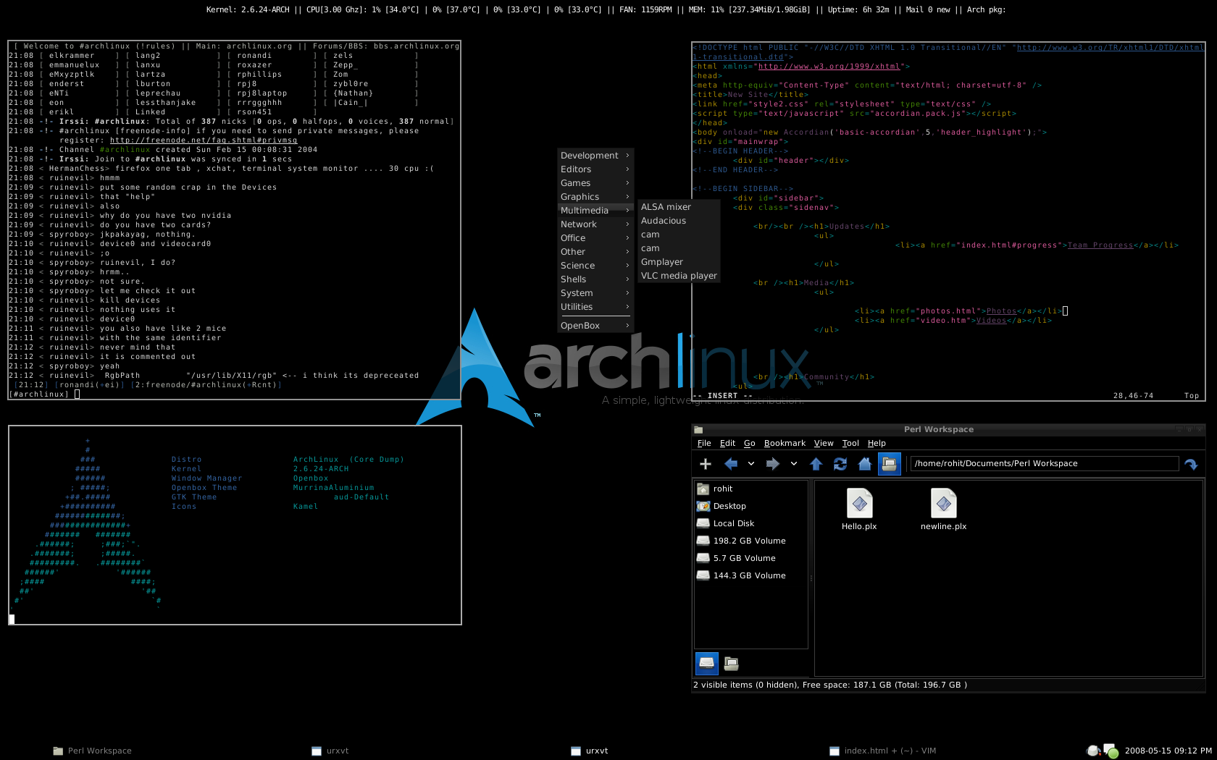
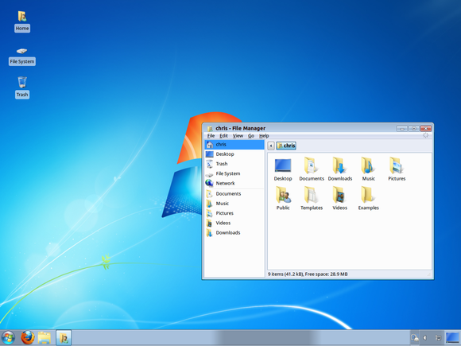
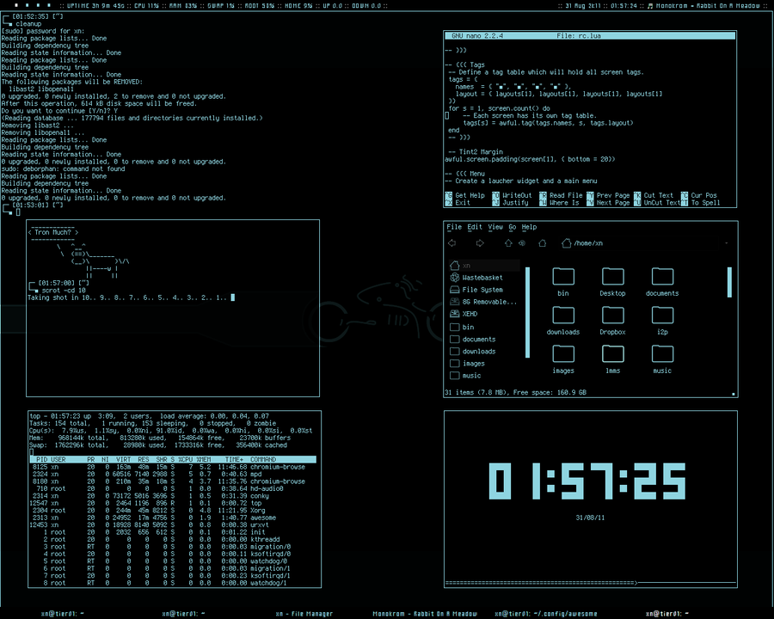
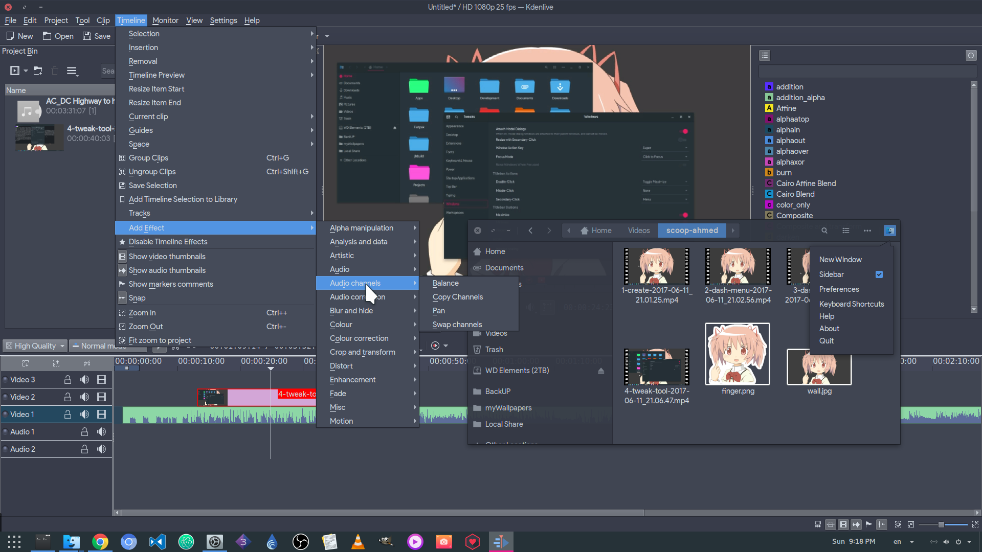
Customisation

Slide 4
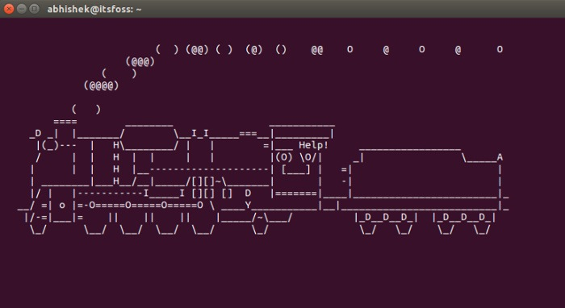
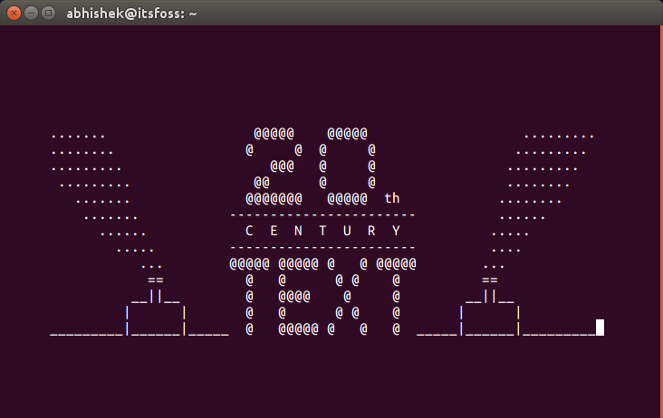

Heart of Linux

Slide 5
Command Line 101
cd /directory change directory
pwd print working directory
ls list contents of current dir
cat abc.txt print file contents
cp A B copy file A to file B
mv A B move/rename A to B
touch abc.txt create a file
mkdir Pictures create a directory
locate abc.txt print location of file
rm [-r] A delete file (-r for directory)
clear empty terminal screen
date display current date and time
man CMD show manual for a linux command

